Slide 1

Testing Social Network WEare
Prepared by: Team4{win}
https://github.com/Alpha-50-group-4-final-project/Group-4-common-repo

Slide 2



Who we are – Team4{win}
All of us Test Managers, Test Analysts, Manual and Automation testers
The beginning - schedule & task split
What issues we faced?
What went well and what could be done better?
Bobi
Annie
Dinko

Slide 3
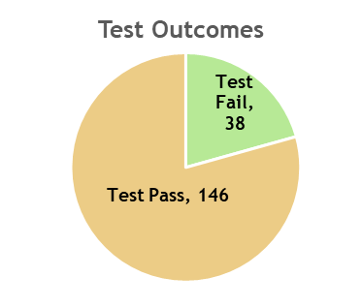
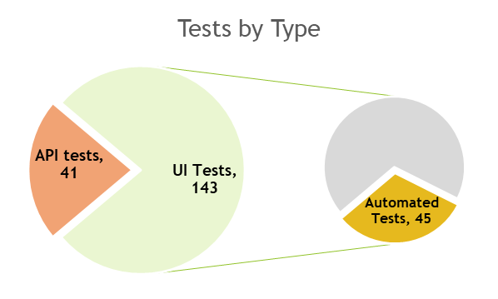
Test Reporting
Number of tests - 184

Slide 4
Bug Reporting
Number of bugs - 38

Slide 5
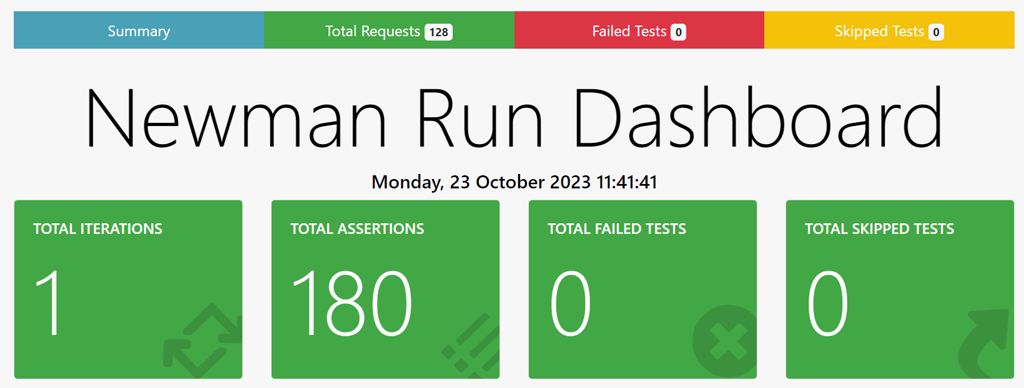
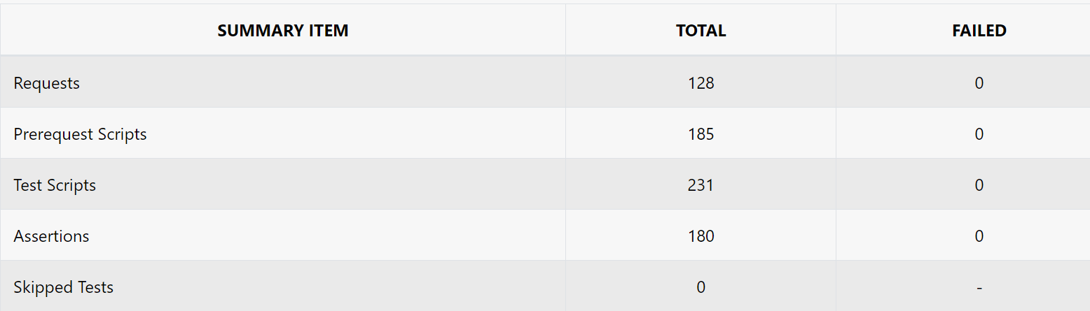
Postman
Organized by Swagger REST controllers
Grouped in Happy & Unhappy Path
Pre-request scripts for data creation
Newman for reporting

Slide 6
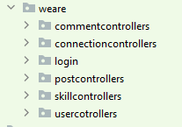

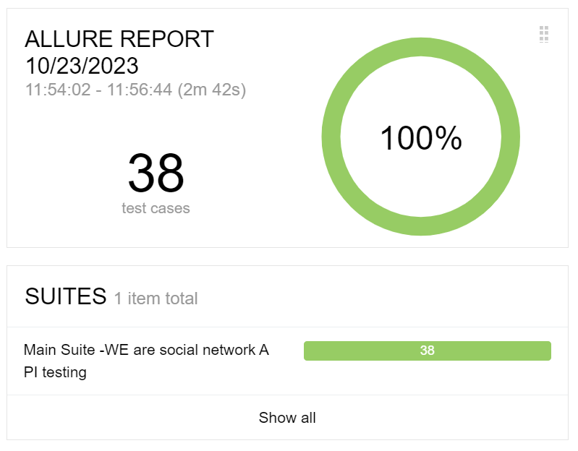
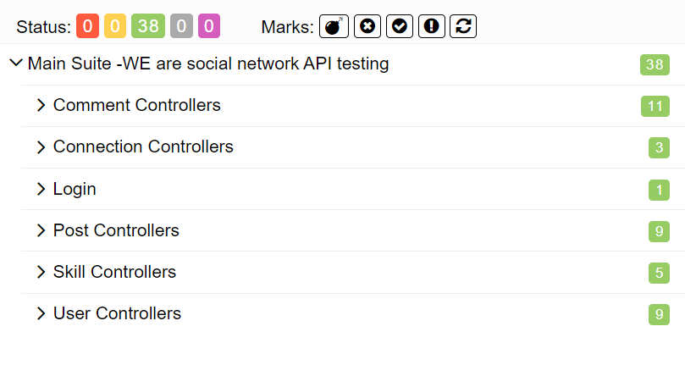
REST Assured
Organized by Swagger REST controllers
Grouped in Main suite (38 tests), Happy & Unhappy path suites
Classes, Database
Allure Reporting

Slide 7
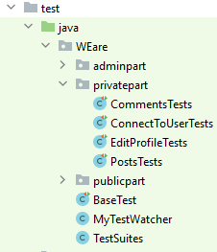
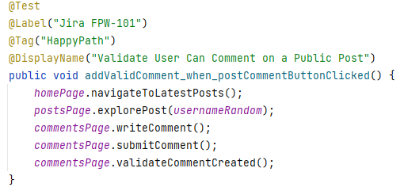
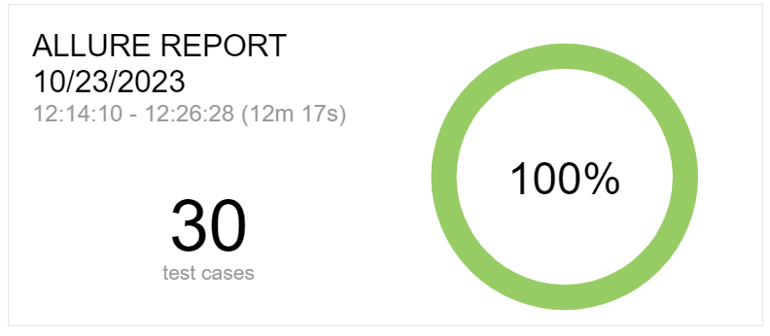
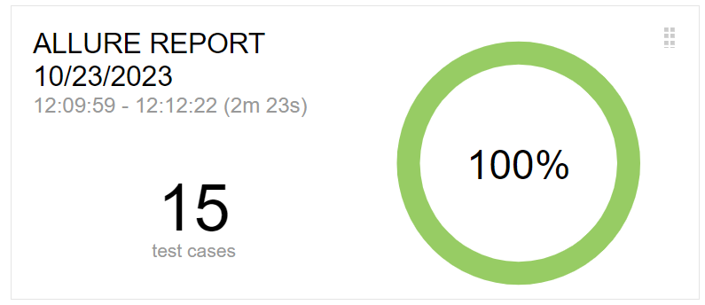
Selenium WebDriver
45 automated test based on Test cases Priority
Ordered by Role and Feature
HappyPath and UnhappyPath test suites
Labels, Tags, DisplayName
API requests for data creation
Allure Reporting

Slide 8
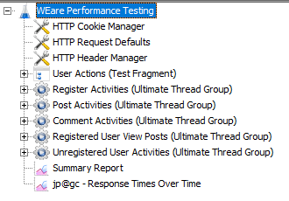
Performance Testing & Security
JMeter
Ultimate Thread Group Plugin
Simulates user journeys: registration, login, posting, commenting
SQL injection and validation login with invalid credentials test

Slide 9


